Slide 1
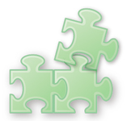










 | by plugin | translate to JavaScript
Java | Java Applet | GWT
C# | Silverlight | Script# JSC
ActionScript | Flash Player | Jangaroo

